Slide 1
Before-or-After Atomicity
面向大量数据的时候锁不合适
锁需要资源
申请锁的时候被占用了，进程状态的从运行到睡眠，再恢复切换很费事。

Slide 2
Before-or-after atomicity
All-or-nothing + before-or-after ----> transaction
  All-or-nothing: crash
  Before-or-after: concurrency
  In the midst of multiple-step atomic action
Definition of “correctness” (as in 9.1.5)
  If every result is guaranteed to be one that could have been obtained by some purely serial application of those same actions

Slide 3
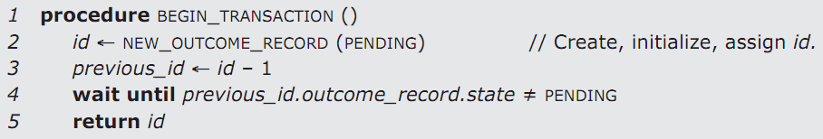
Simple serialization
Simple serialization: similar as lock-step
  Transaction n waits transaction n-1 to complete
Drawbacks: too strict
  Prevents all concurrency among transactions
  Suitable for applications without many transactions
Next of this chapter are nothing but optimizations

Slide 4
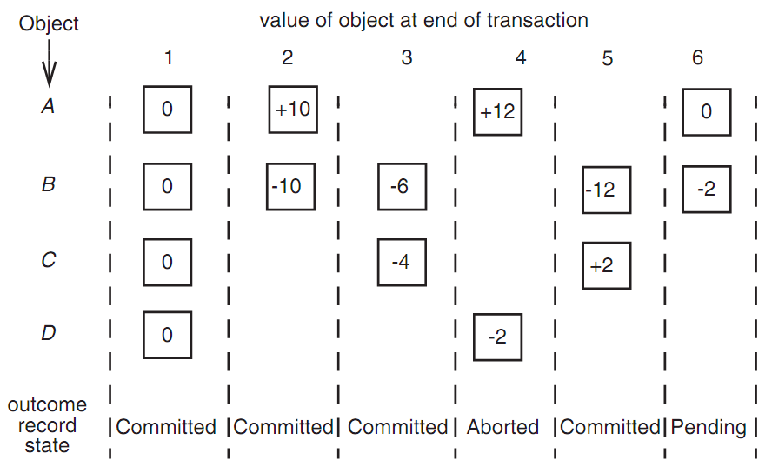
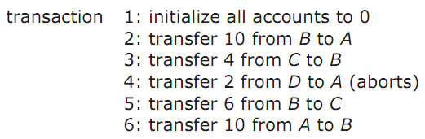

Slide 5
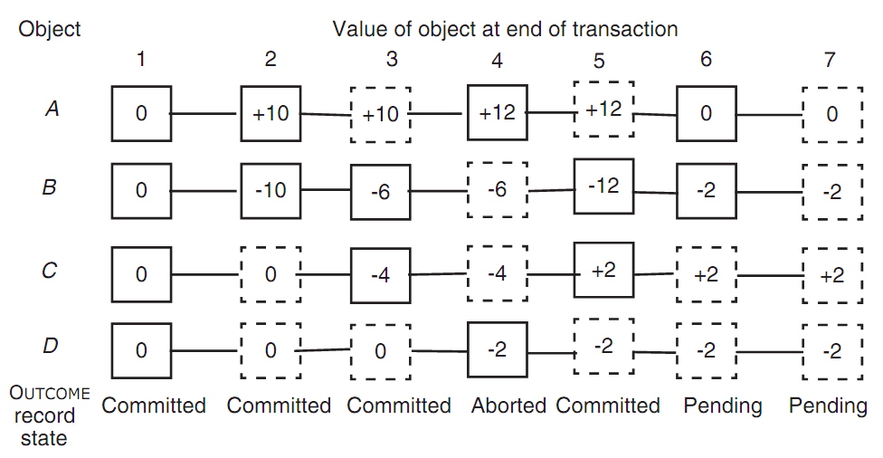
More relaxed disciplines that still guarantee correctness
We don’t care when things happen
  Transaction-3 can create new version of C before transaction-2
  Transaction-4 can run concurrently with transaction-3

Slide 6
Mark-point discipline
Step-1: wait for pending version
Step-2: mark data to be updated
  Create a pending versions of every variable it intends to modify --- mark point
  Announce
    By MARK_POINT_ANNOUNCE, simple set a flag
Step-3: keep discipline of mark point:
  No transaction can begin reading its inputs until the preceding transaction has reached its mark point or is no longer pending

Slide 7
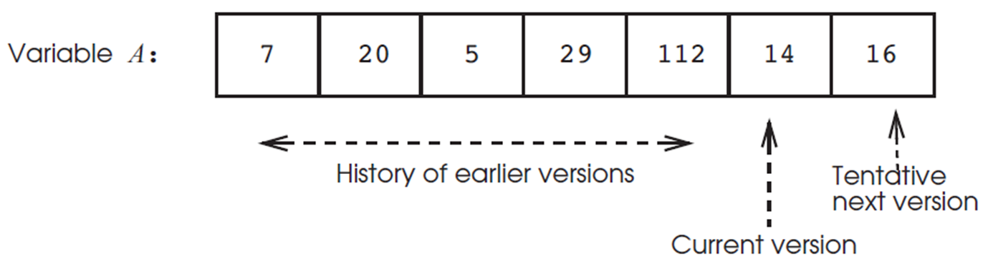
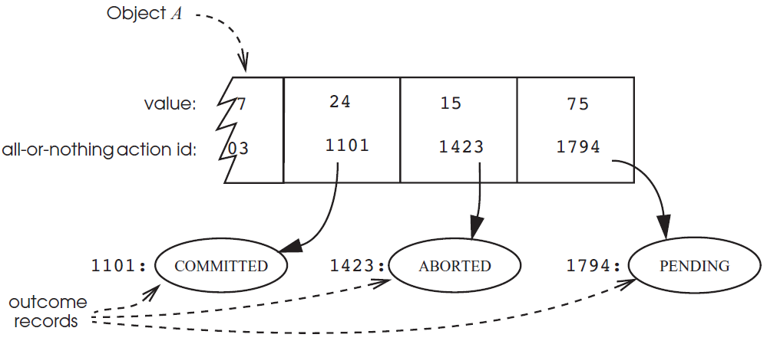

Slide 8
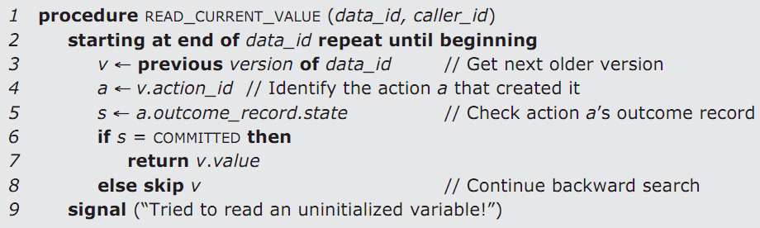

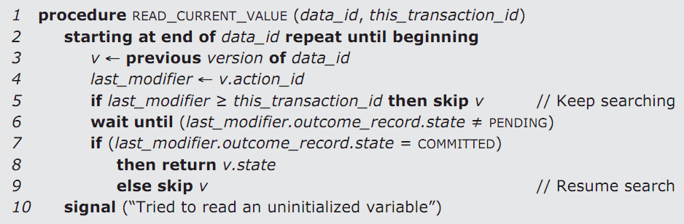
Waiting, instead of skipping

Slide 9
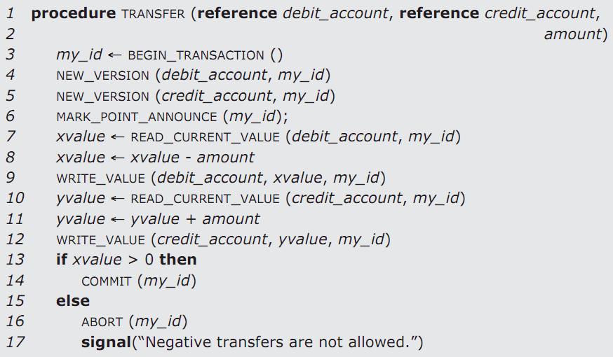

Slide 10
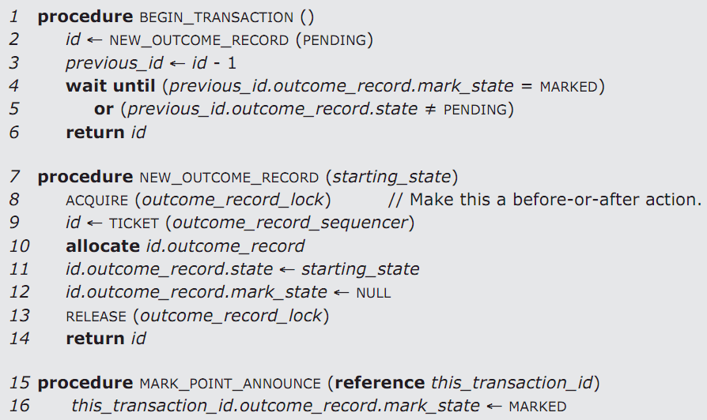
//pending

Slide 11
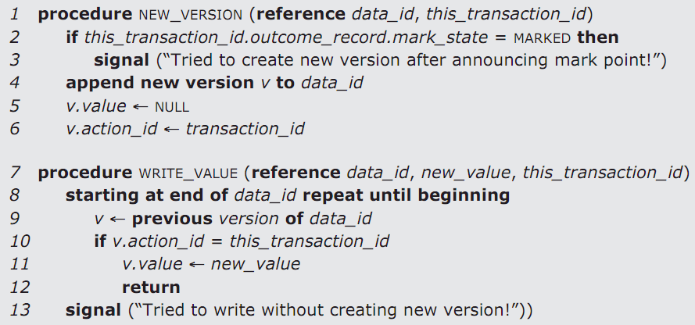
Mark-point versions of WRITE_NEW_VERSION()

Slide 12
Mark-point discipline
Distribute delays
  Some in BEGIN_TRANSACTION()
  Some in READ_CURRENT_VALUE()
Bootstrapping
  Goal: before-or-after for general programs
  Solution: special case of a “new outcome record”
Three layers
  MARK_POINT -> before-or-after
  NEW_OUTCOME_RECORD
  TICKET, REQUIRE, RELEASE

Slide 13
Mark-point: no deadlock
Wait only earlier transaction
  Earliest ones wait no one
  Guarantee progress
  Lock will not guarantee progress
    Require additional mechanisms to ensure no deadlock
Two minor points
  Reduce to simple serialization discipline
    If wait to announce mark point until commit or abort
  Two possible errors
    Never call NEW_VERSION after mark point
    Never try to write a value without new version

Slide 14
Read-capture: optimistic atomicity
Pessimistic methods
  Presume that interference is likely
  Prevent any possibility of interference actively
  Simple serialization & mark-point
Optimistic methods
  Allow write in any order and at any time
  With the risk that “sorry, interfere write, you must abort, clear the history and then retry”
  Read-capture discipline

Slide 15
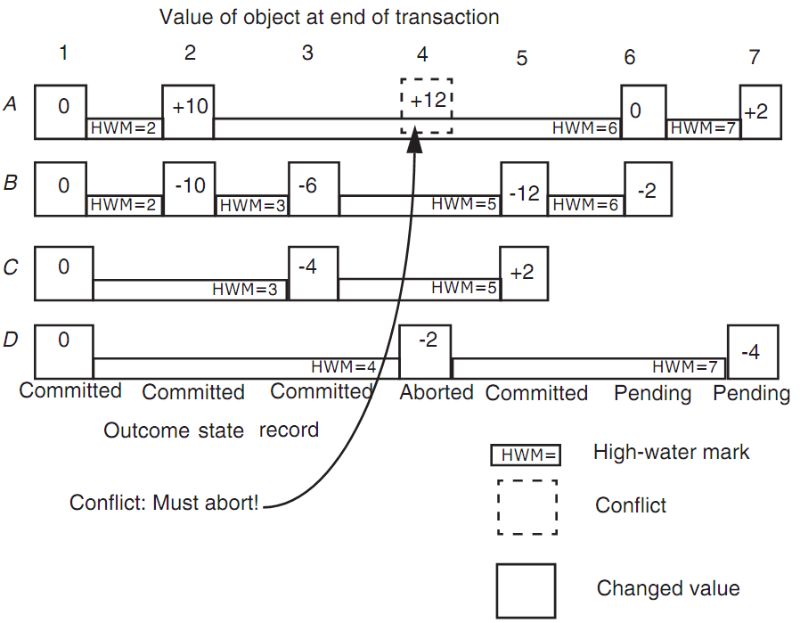
Transaction-4 was late
Transaction-6 has already read A
Transaction-4 has to redo as 7

Slide 16
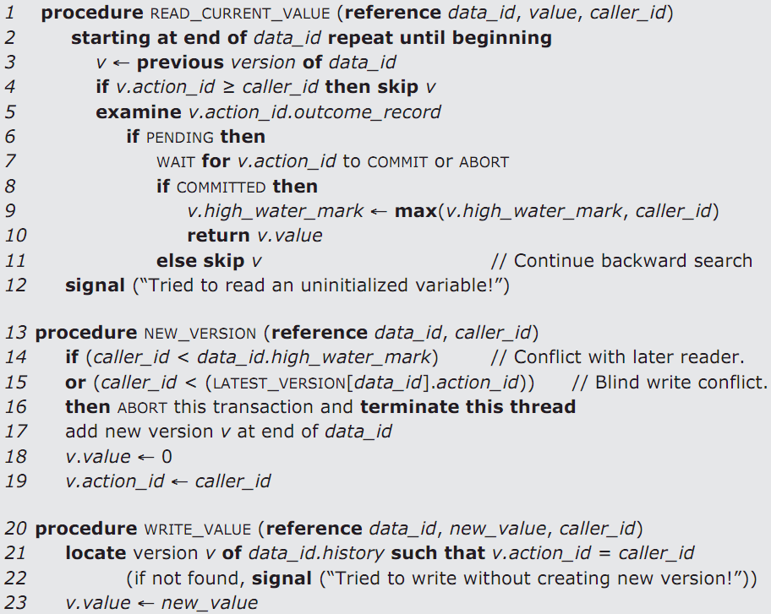
=、

Slide 17
Read-capture’s correctness
Correctness
  1. WAIT for PENDING in READ ensures that transaction n will wait for k to commit or abort (k<n)
  2. High-water mark in READ and test in NEW_VERSION ensures transaction j will abort if n has read the object (j < n)
  3. Therefore, every value that READ returns to transaction n will include effect of 1…n-1
  4. Therefore, every transaction n will act as if it serially follows transaction n-1
Price of optimism
  Later transaction may cause earlier ones to abort
  Suitable for those application without a lot of data interference

Slide 18
Use version histories for before-or-after atomicity
Register renaming
  Pentium-4 only has 8 architectural register
  Has 128 physical register
  Renaming by reorder buffer
    Assigning a slot in the reorder buffer
      NEW_OUTCOME_RECORD & NEW_VERSION
    Committing instruction
      WRITE_VALUE & COMMIT

Slide 19
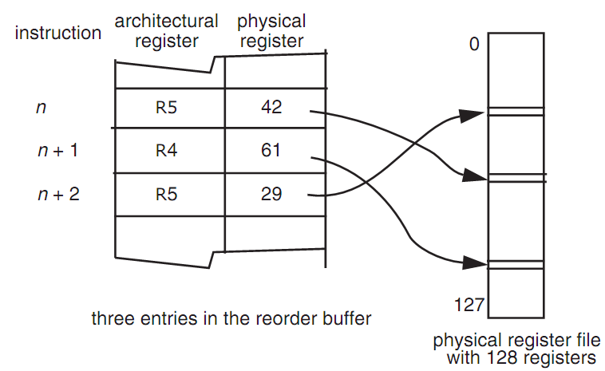

Register renaming

Slide 20
Use version histories for before-or-after atomicity
Oracle database’s serializable
  Snapshot isolation
  When a transaction begins
    System takes a snapshot of every committed value
    Read all of its inputs from that snapshot
  If two concurrent transaction modify the same variable
    The first one to commit wins
    Aborts the other one with “serialization error”

Slide 21
Use version histories for before-or-after atomicity
Transaction memory
  Allow concurrent threads without locks
    Mark the beginning of an atomic instruction sequence with a “begin transaction” instruction
    、、、、、、、Direct all STORE to a hidden copy
    Check interference at end
  Even more optimistic than read-capture
  Most useful if interference is possible but unlikely
  Hardware or software implementation

Slide 22
9.5 Pragmatics: lock
Lock: a flag associated with a data object to warn concurrent actions not to read or write the object
  ACQUIRE (A.lock) / RELEASE (A.lock)
    Only one will succeed
  Problems
    Easy to make error to race
    Difficult to find out why
  Three steps
    Discipline specifies which locks must be acquired and when
    Establish a compelling line of reasoning that concurrent transactions that follow the discipline will ensure before-or-after
    Interpose a lock manager to enforces the discipline

Slide 23
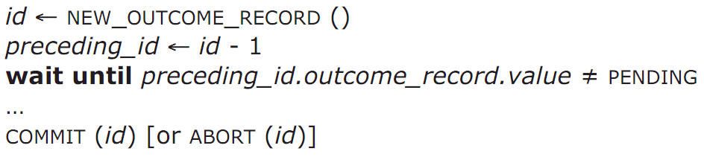
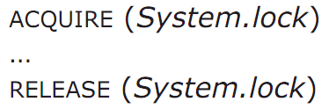
System-wide locking
System-wide lock
  begin_transaction
  ACQUIRE (System.lock)
  …
  …
  RELEASE (System.lock)
  end_transaction
Allow only one transaction to run at a time
Serialize potentially concurrent transactions in the order that they call ACQUIRE

Slide 24
Simple locking
Simple locking
  1. Acquire a lock for every shared data in advance
  2. Release locks only after commit or abort
Lock point (similar as mark-point)
  Lock set: locks acquired when reaches lock point
  Lock manager’s enforcement
    Intercept read/write/commit/abort, and check
Problems
  How to enumerate all shared object to access?
  The set of might access may be larger than does access

Slide 25
Two-phase locking
Two-phase locking (similar as read-capture)
  Avoids to know lock set in advance
  Acquire locks as it proceeds, access data as soon as it acquires the lock
Constraints
  Not release any locks until passes lock point
  Only release a lock if never need to read/write again
Problems
  Widely used, but hard to argue correct

Slide 26
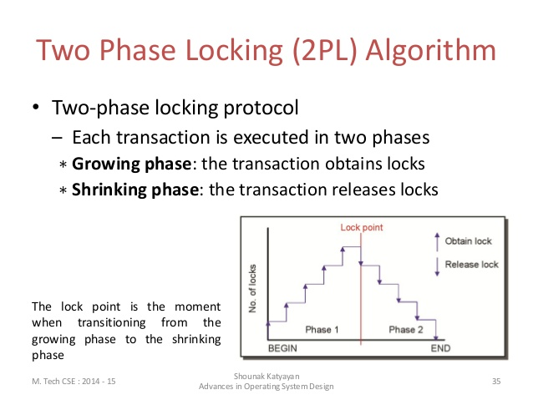

Slide 27
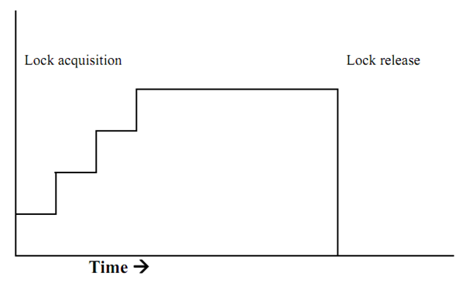
Strict 2 phase locking

Slide 28
Two-phase locking
Unnecessary blocking
  Example
    T1: READ X
    T2: WRITE Y
    T1: WRITE Y
    T1’s & T2’s lock sets intersect at Y
  Two-phase locking prevents interleaving
    But T1/T2/T1 = T2/T1/T1
    NP-complete

Slide 29
Summary
Version History | Locks
Simple serialization | System-wide lock
Mark-point discipline | Simple locking
Read-capture | Two-phase locking

Slide 30
Interactions between locks and logs
Transaction abort
  Restore its changed data before release lock
  Just like committed transactions doing nothing
System recovery
  Whether the locks themselves should be logged?
    Locks are in volatile memory------is ok？？？？？
    No pending after recovery, thus no locks
  Non-complete transactions have no overlapping lock sets at the moment of crash

Slide 31
Performance optimizations
Physical locking VS. logical locking
  Choose lock granularity
    E.g. change 6-byte object of a 1000-byte disk sector,
    or change 1500-byte object on two disk sectors
    Which to lock: the object or sector?
  Logical locking
    If objects are small: more concurrency, more logging
    New logical layer between app and disk
      E.g. data object management and garbage collection
  Physical locking
    Tailor the logging and locking design to match disk granularity
      Disk sectors rather than object is a common practice

